Slide 1


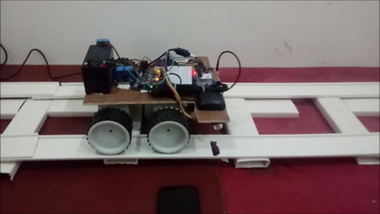
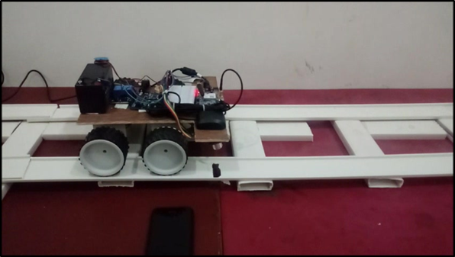
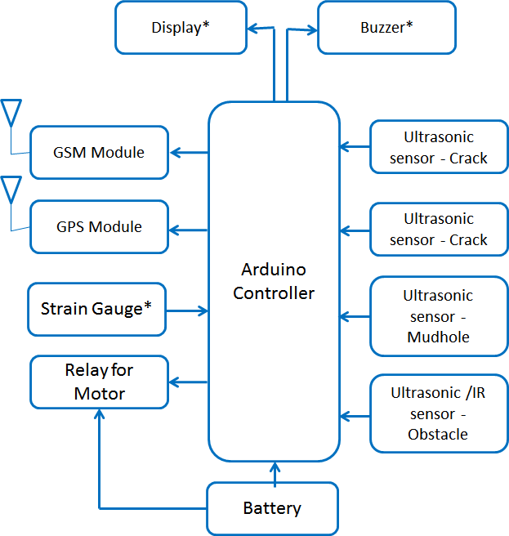
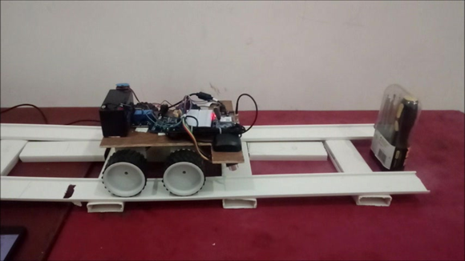
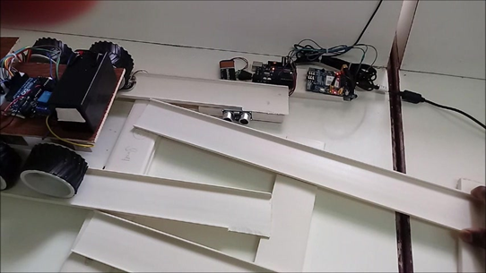
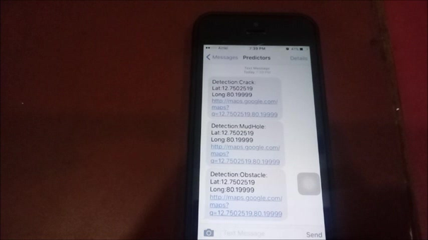
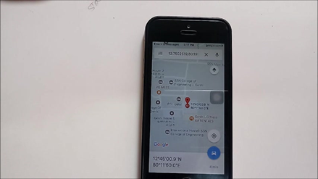
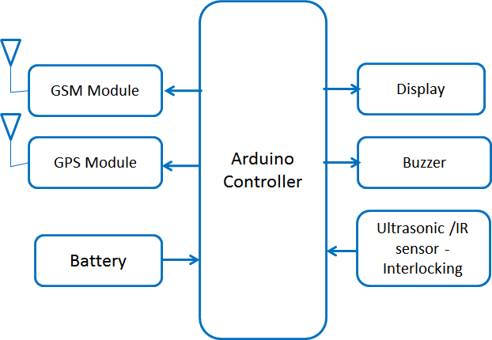
Continuous Monitoring of the Condition of Railway Tracks
Praveen S , Arunkumar B | Dr.Kishore | SSN College of Engineering
Objective
Block Diagram
Results
To propose a condition monitoring system that can detect faults before they intensify and improve safety
To identify sensors that will be suitable for detecting various faults in the railway tracks and configure those sensors into a system
Figure: Crack Detection
Figure: Mudhole Detection
Motivation
From the literature it is evident that 40% of Indian Railways tracks are used beyond capacity
Railway accidents are for the most part grouped either by their effects, e.g.: head-on collisions, rear-end collisions, side collisions, derailments, fires, explosions, etc. or by their cause, e.g.: driver and signalman error, mechanical failure of tracks and bridges, level crossing misuse and trespassing, etc. or by natural causes such as flooding and fog.
Manual inspection is being done to detect these faults in tracks which is time-consuming and considering the fact that the tracks extend to great lengths, it is practically impossible to examine the whole track manually
Hence overworked tracks make train travel unsafe, which leads to the requirement for regular monitoring and maintenance of railway tracks.
Figure: Obstacle Detection
Figure: Interlocking Detection
Figure: Block Diagram for Inspection Bot
Figure: SMS Alert
Figure: GPS Location
Conclusion
The proposed system for condition monitoring of railway tracks proves to be a reliable one. By using ultrasonic sensor , and the GPS/GSM module the most common faults encountered in the railway tracks maintenance such as crack detection, obstacle detection, mud hole detection, and interlocking were successfully sensed and an alert message was sent.
This prototype has been developed as a proof of concept, for railway monitoring system hence when implementing it in real time instead of using ultrasonic sensor, high-end sensors (sensors which have high deduction capacity) can be used.
Future work includes implementation of automatic breaking system, IoT based monitoring and control system
Problem Statement
To detect the presence of mud holes, ballast for tamping and generate warning
Detect defects in the internal structure of the railway bridge due to heavy loads passing on it (Ultrasonic sensor is used for this purpose)
Sense the interlocking disabilities found on the track, which occur due to presence of unnecessary objects (ultrasonic sensor has been used)
Figure: Block Diagram for Interlocking System
Notes:
To change this poster, replace our sample content with your own. Or, if you'd rather start from a clean slate, press the New Slide button on the Home tab to insert a new page. Now enter your text and pictures in the empty placeholders. If you need more placeholders for titles, subtitles or body text, copy any of the existing placeholders, then drag the new one into place.

